Slide 1
Introduction to ACC Workshop on Differentiable Programming for Modeling and Control of Dynamical Systems
Presenter: Dr. Sonja Glavaski
Strategic Advisor
PNNL-SA-181885
Notes:
Image: Abstract Data Visualization – Stock Photo

Slide 2
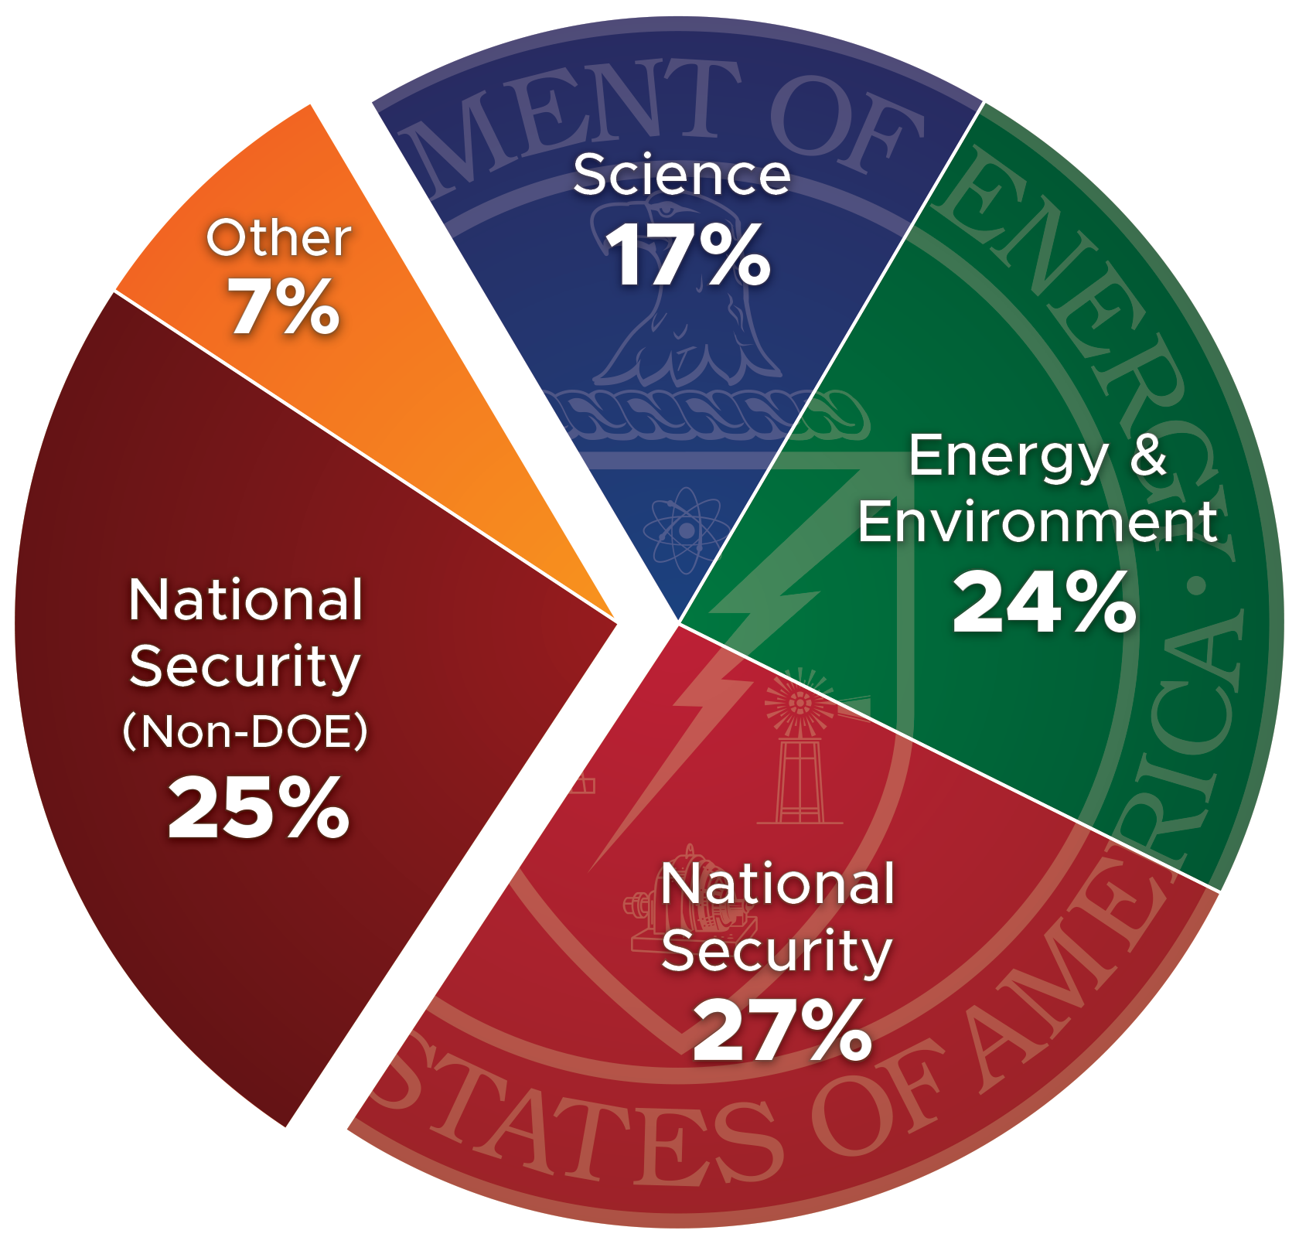




PNNL is one of DOE’s most diversified national laboratories
$1.34B
Spending
5,700
Staff
1,905
Peer-reviewed
Publications
272
Invention
Disclosures
FY 2022 Spending
Notes:
In FY 2022, PNNL had $1.34 billion in spending (or business volume) and $1.55 billion in funding (or sales). We ended FY 2022 with 5,702 staff (rounded here to 5,700).
The pie chart reflects the distribution of spending by sponsor for FY 2022.

Slide 3





PNNL is advancing scientific frontiers and providing solutions to critical national needs
Notes:
Pacific Northwest National Laboratory advances scientific discovery and drives innovations that enable sustainable energy and enhance national security. PNNL distinguishes itself by focusing on three areas reflected in the “orb.”
Scientific Discovery – PNNL draws on signature capabilities in chemistry, earth sciences, and data analytics to advance scientific discovery and create solutions to the nation's toughest challenges.
Sustainable Energy – PNNL’s expertise in energy production, storage, delivery, and efficiency distinguish its energy sustainability mission and drive the development of technologies that further improve our nation’s energy security.
National Security – PNNL advances science-based solutions for long-term U.S. missions in nuclear and radiological security, critical infrastructure protection, and addressing chemical and biological threats.

Slide 4

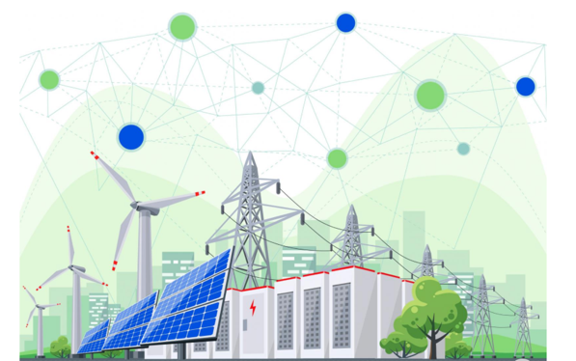
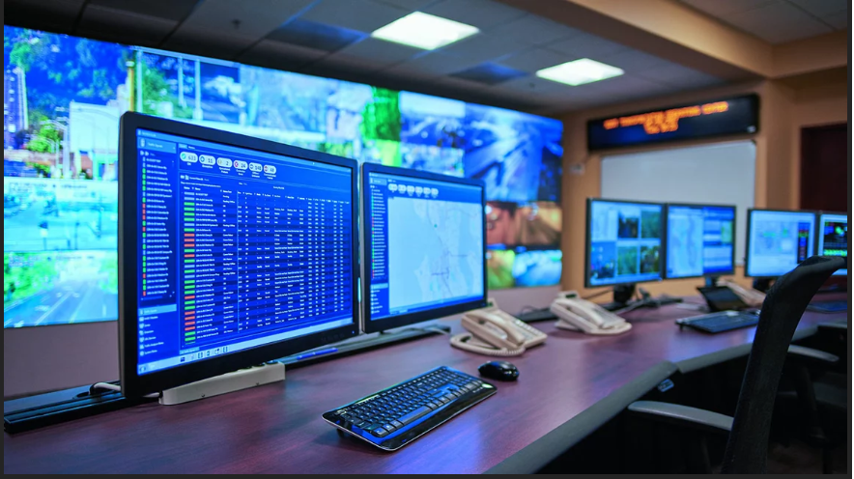
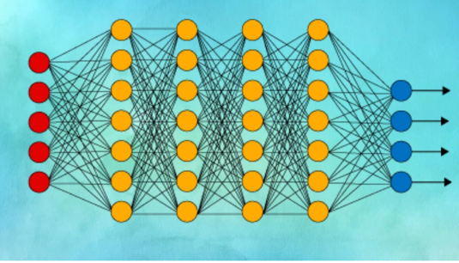
Sponsored AI Research at PNNL
Working with DOE SC to develop new AI methods and computation paradigms for scientific discovery
Working with ARPA-E, AITO, and DOE applied energy offices in engaging AI capabilities to support their mission objectives in:
Energy Efficiency (including buildings)
Renewables (including wind)
Power grid
Manufacturing
Transportation
Developing and Managing Data Repositories

Slide 5
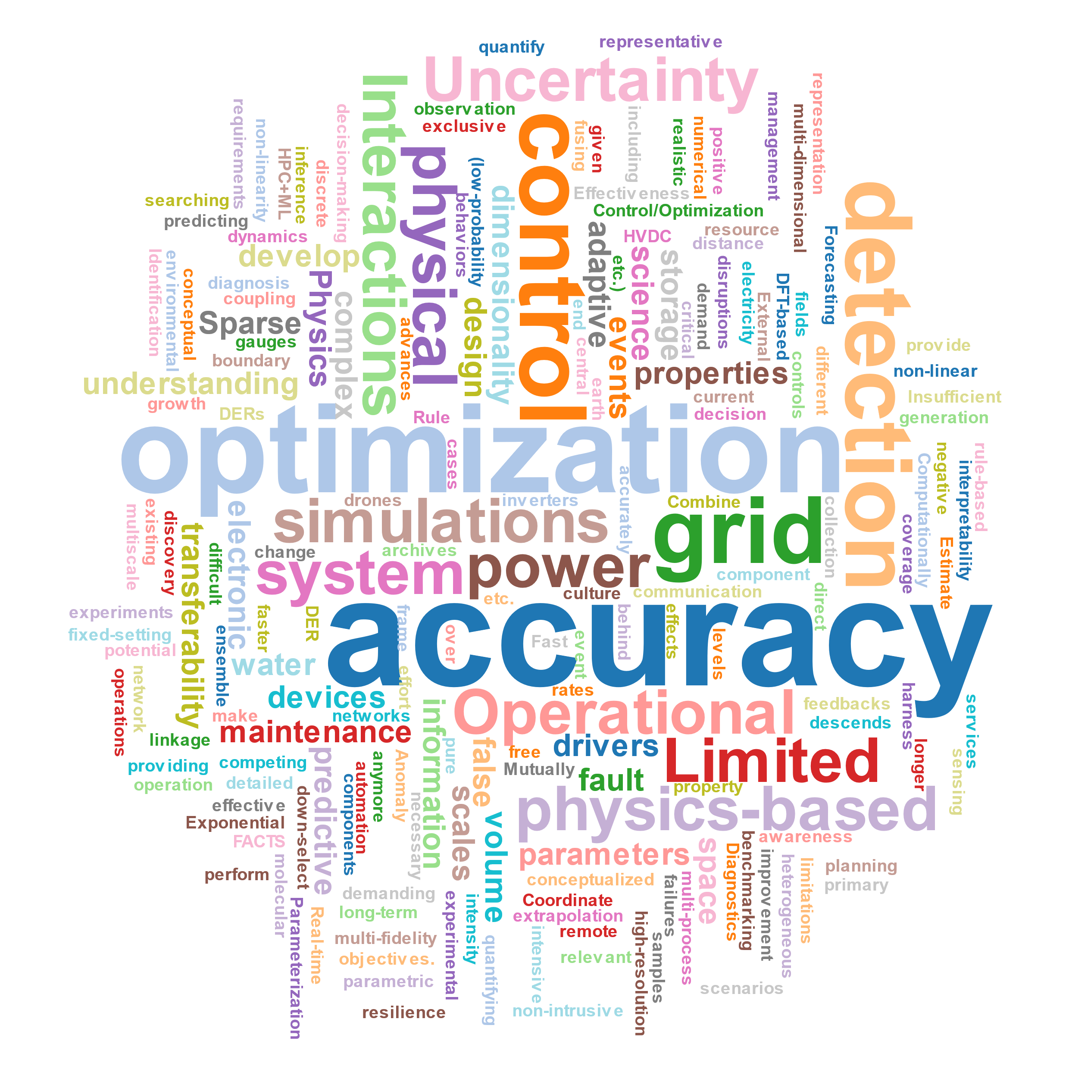
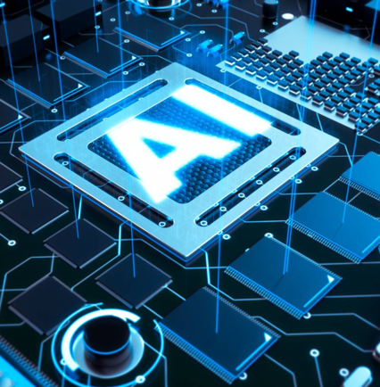
Overarching Research Challenges
Learning from limited and uncertain multi-modal data
Generation of high-quality and high-coverage data is costly and often unfeasible.
Integrating data with physics models
Convergence of physical, computational and data sciences requires foundational advances in AI/ML and computing.
Advancing computing systems to support heterogeneous workloads
Novel computing frameworks and heterogenous system-on-a-chip designs for converged applications require co-design.
Developing AI based operational tools
Utilize AI in combination with control approaches to develop systems that adapt in real-time to system abnormalities, recover from severe disruptions, and are responsive to human

Slide 6
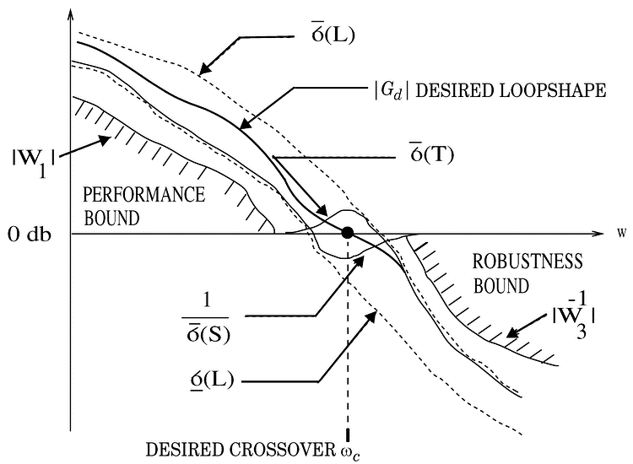
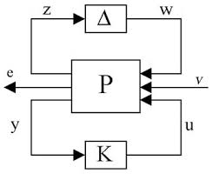
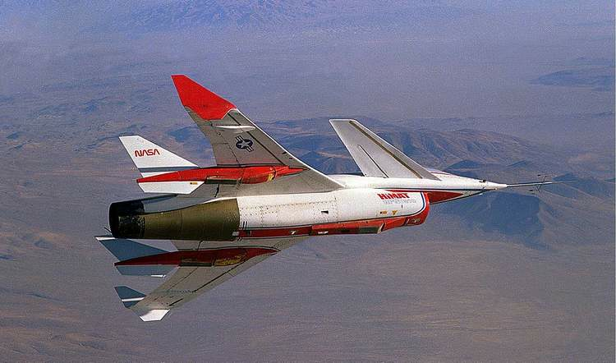
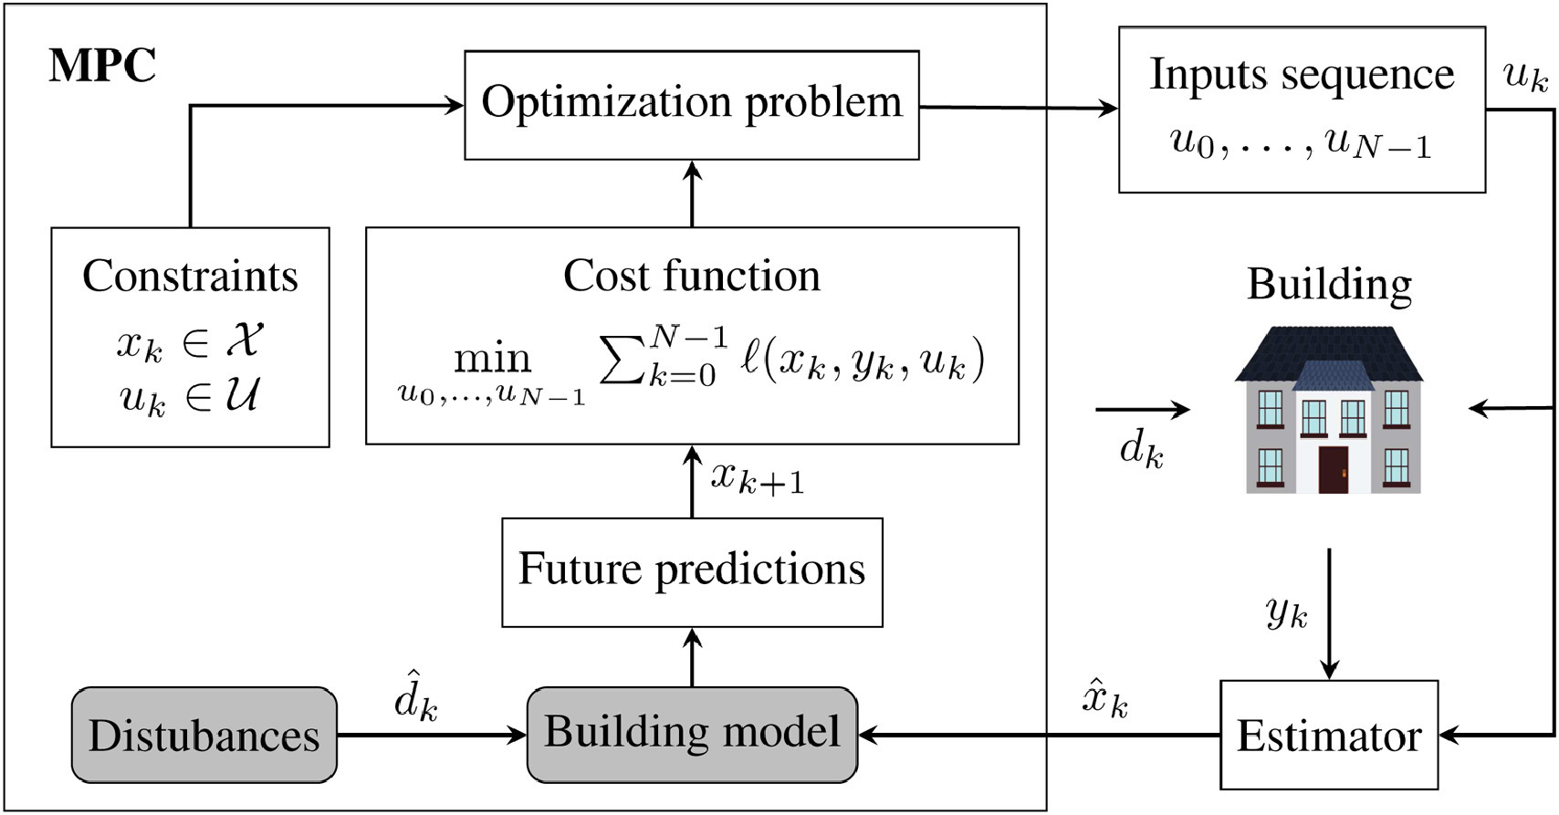
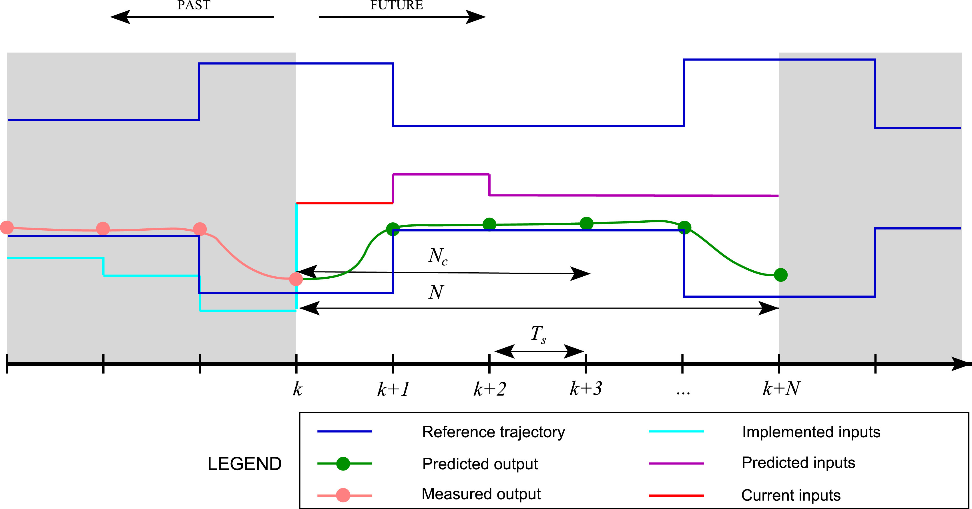
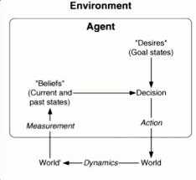
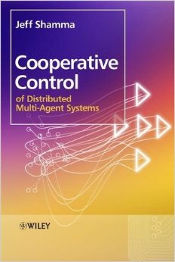
Classic Control Toolbox
Uncertainty Management - Robust Control
Advantage: Optimal performance for systems with parametric and dynamic uncertainty
Challenge: Conservative Solution, Sometimes hard to implement
Constraint Management - Model Predictive Control
Advantage: Optimal performance; automatic constraint prioritization
Challenge: Sensitive to modeling error, Convergence in real-time; Distributed solution hard
Complexity/Scale Management - Agent Based Control
Advantage: Low computation and communication requirements, easy to implement
Challenge: Hard to guarantee performance

Slide 7
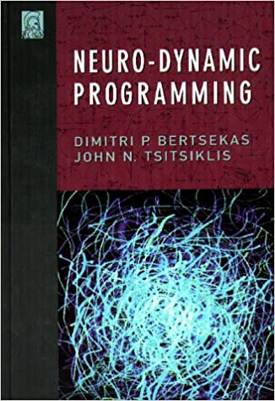
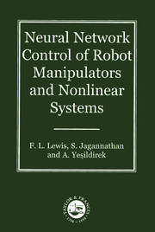
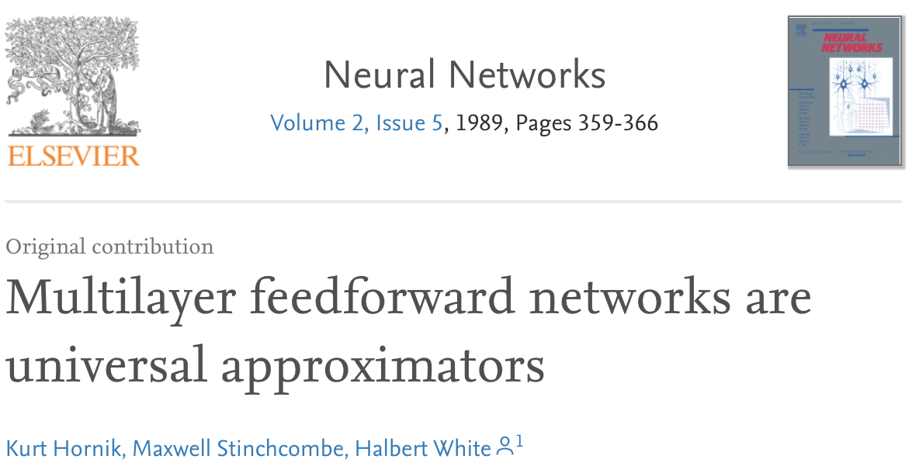
Neural Networks in Control
1996 – rigorous explanations of reinforcement learning through the lens of dynamic programming and practical use of function approximation
1999 – rigorous development of training dynamics and practical use of function approximation with performance guarantees during learning
Notes:
In 1989 – Hornick, Stinchcombe, and White and multilayer feedforward networks are a class of universal approximators
In 1996, Bertsekas and Tsitsiklis publish neuro dynamic programming showing the uses neural network approximations to overcome the "curse of dimensionality" and the "curse of modeling" that have been the bottlenecks to the practical application of dynamic programming and stochastic control to complex problems.
In their 1999 book, Lewis study the closed-loop applications, and properties of NN controllers in rigorous detail using mathematical stability proof techniques. They show how to design neurocontrollers and at the same time guarantee stability and performance.
Why didn’t these wonderful theoretical results and techniques have been adopted then in engineering practice?
It may have been because the software tools for specifying and training these neural architectures were not available.

Slide 8

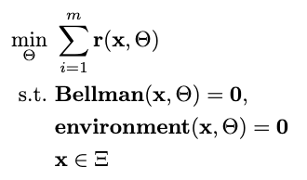

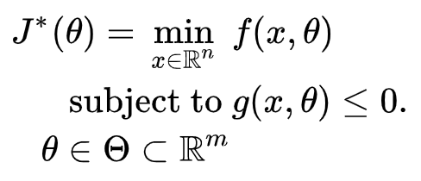

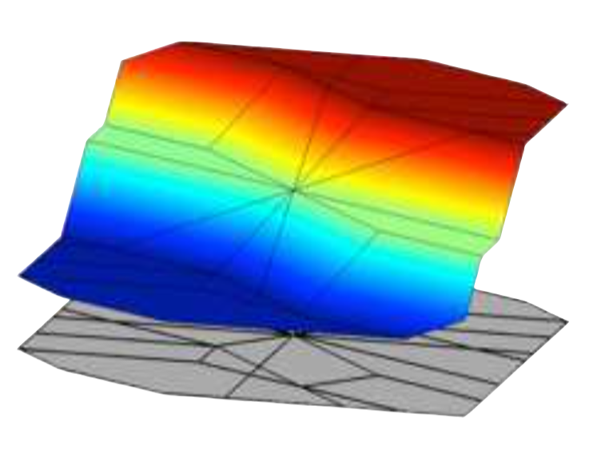
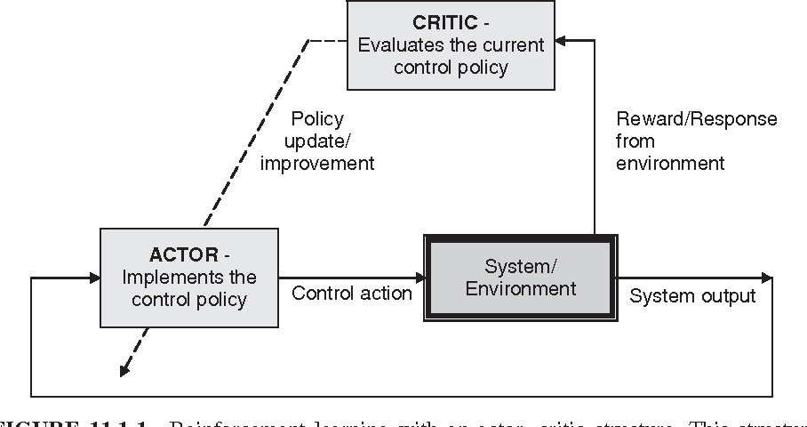

Landscape of Optimization Methods
Online optimization
Parametric programming
Supervised Learning
Reinforcement Learning
“online” solution for given parameter values
computationally demanding in real-time
“offline” optimization obtains a solution map
classical methods lead to exponential complexity!
“offline” optimization
obtains a model (map)
scalable but requires expert optimizer to imitate
“offline” optimization
obtains a policy map
classically can’t handle constraints
Classic Control Toolbox
Neural Networks in Control

Slide 9

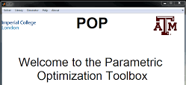
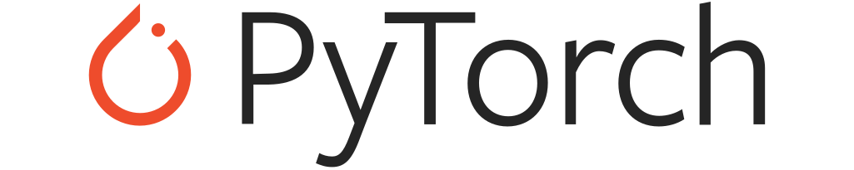

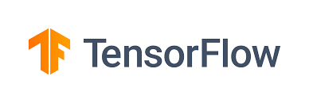

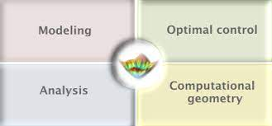

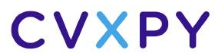
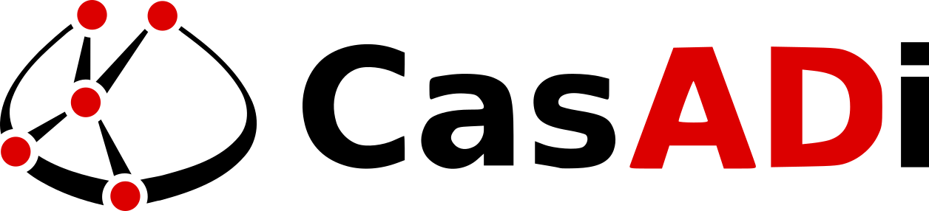
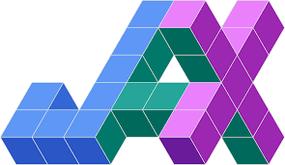


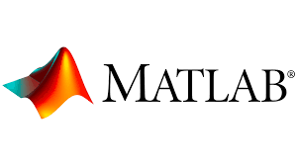
Landscape of Optimization Tools
Online optimization
Parametric programming
Supervised Learning
Reinforcement Learning
Multi-parametric Toolbox (MPT)
Classic Control Toolbox
Neural Networks in Control

Slide 10
Landscape of Optimization Tools
Online optimization
Parametric programming
Supervised Learning
Reinforcement Learning
Multi-parametric Toolbox (MPT)
What comes next? … Differentiable programming (DP): a unifying approach for data-driven optimization with solutions based on automatic differentiation (AD)

Slide 11
Differentiable Programming Enables a Wide Array of Applications
Differentiable Programming
M. Innes, et al., A Differentiable Programming System to Bridge Machine Learning and Scientific Computing, 2019
Physics-informed Neural Networks
M. Raissi, et al., Physics-informed neural networks: A deep learning framework for solving forward and inverse problems involving nonlinear partial differential equations, 2019
Neural Differential Equations
R. T. Q. Chen, et al., Neural Ordinary Differential Equations, 2019
C. Rackauckas , et al., Universal Differential Equations for Scientific Machine Learning, 2021
Differentiable Optimization
A. Agrawal, et al., Differentiable Convex Optimization Layers, 2019
P. Donti, et al., DC3: A learning method for optimization with hard constraints, 2021
S. Gould, et al., Deep Declarative Networks: A New Hope, 2020
J. Kotary, et al., End-to-End Constrained Optimization Learning: A Survey, 2021
Differentiable Control
B. Amos, et al., Differentiable MPC for End-to-end Planning and Control, 2019
S. East, et al., Infinite-Horizon Differentiable Model Predictive Control, 2020

Slide 12
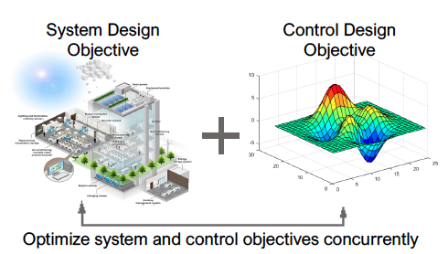

Differentiable Programming Enables New Control Paradigms
ML Based System & Control Co-Design
Systems are becoming more complex with significant intersystem couplings that are less understood
Enable design and operation of systems for multiple objectives
Address need to incorporate and evaluate control options early in the project design cycle
Simulation-based modeling and control
Simulations are crucial for decision-making
Improve computational efficiency and scalability for heterogenous scientific simulations
Use data to optimized explicit predictive control policy

Slide 13
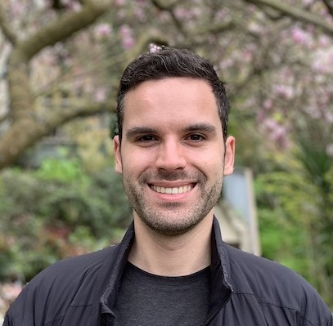


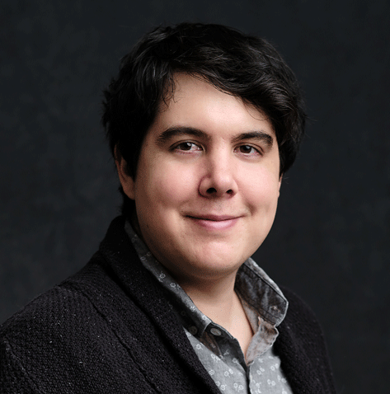
Invited Speakers
Boris Ivanovic (NVIDIA)
Mario Zanon (IMT Lucca)
Bingqing Chen (Bosh AI)
Chris Rackauckas
(MIT)

Slide 14


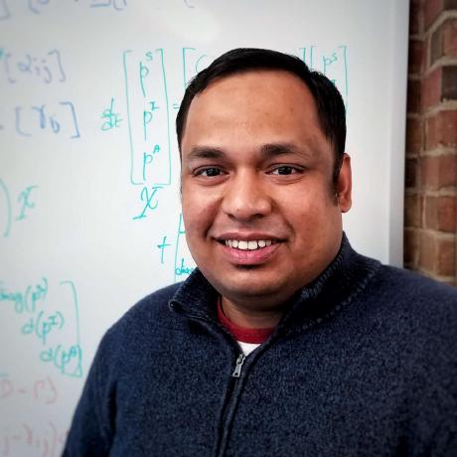

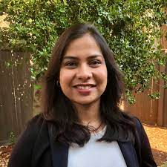




Workshop Organizers
Jan Drgona
Aaron Tuor
Biswadip Dey
Wenceslao Shaw Cortez
Soumya Vasisht
Draguna Vrabie
https://www.pnnl.gov/projects/mars
Notes:
I give my thanks to the organizers for the invitation to speak at the Workshop
I’ll thank our many collaborators from PNNL and elsewhere for making this work exciting.
I want to acknowledge the support of our sponsors at the department of energy and ARPA-E and PNNL’s internally funded initiatives that have enabled this exciting research.
Thank you, all of you, from whom I am always learning so much.

Slide 15
Workshop Schedule
08:30 am - 09:00 am - Sonja Glavaski-Radovanovic (PNNL): Opening remarks and overview of differentiable programming
9:00 am - 9:30 am - Boris Ivanovic (NVIDIA): Differentiable robotics
9:30 am - 10:00 am - Biswadip Dey (Siemens): Learning Hamiltonian dynamics with control
10:00 am - 10:30 am - Coffee break
10:30 am - 11:00 am - Mario Zanon (IMT Lucca): Differentiating MPC with applications in Reinforcement Learning
11:00 am - 11:30 am - Bingqing Chen (Bosch Center for AI): Towards safe and sample-efficient autonomous energy systems via differentiable programming
11:30 pm - 1:00 pm - Lunch Break
1:00 pm - 2:00 pm - Chris Rackauckas (MIT): Code tutorial 1: Julia
2:00 pm - 3:00 pm - Aaron Tuor (PNNL): Code tutorial 2: PyTorch
3:00 pm - 3:30 pm - Coffee break
3:30 pm - 5:00 pm - Jan Drgona (PNNL): Code tutorial 3: PyTorch

